Slide 1
IDS 312 Business Project Management
January 10, 2022

Slide 2
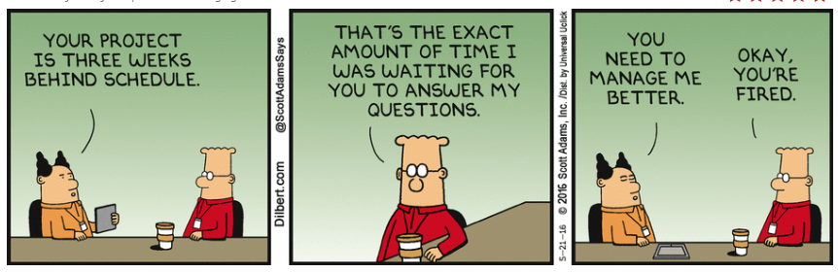
IDS 312 – Business Project Management

Slide 3
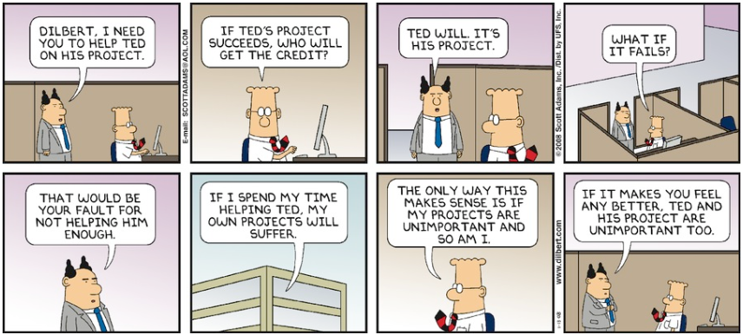

Slide 4
Topics
Course Introduction
See Syllabus v1
Course Approach
Introductions
Course Overview

Slide 5
Course Approach
Concepts/Definitions
Textbook
Homework
Demonstrate working knowledge of PM approaches and tools
Exams
Real world understanding
Team Workshops
Work as team to insure you understand how to use various PM approaches and tools
Team Project
You will be working as a team across the entire semester
Team will select a project and set of objectives
Create a project plan (document and MS Project) in stages
Multiple ungraded and graded deliverables across semester

Slide 6
Introductions

Slide 7
What Is a Project?
Project Defined
Complex, nonroutine, one-time effort
Limited by time, budget, resources, and performance specifications
Designed to meet customer needs
No matter your major, you will be involved in projects in the real world

Slide 8
Managing Deliverable Dimensions
Schedule (When - Timetable)
Cost (How much – Budget and Resources)
Performance (What – Meeting specifications)

Slide 9
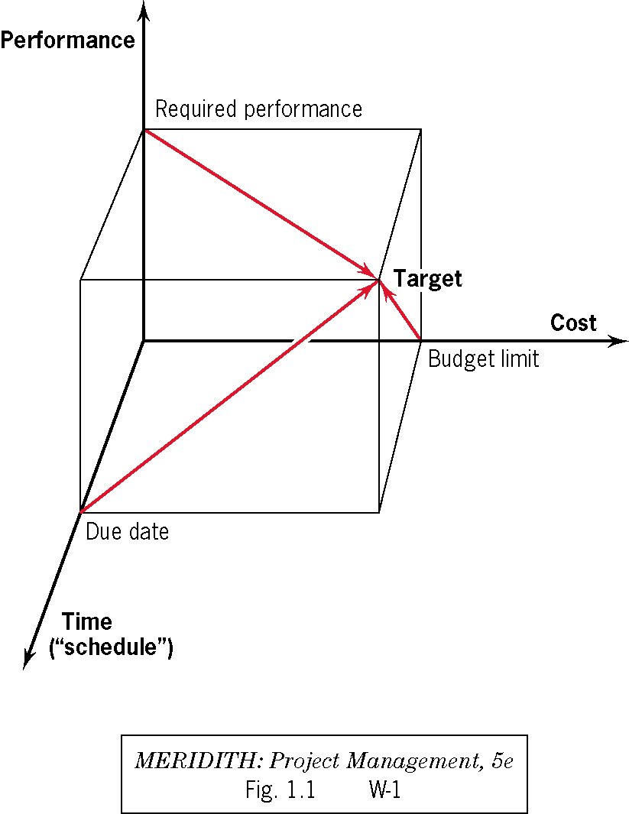
Project Management
Achieving
Performance/Scope
Cost
Time
Customer
Satisfaction
9

Slide 10
Project Management Processes
Monitoring and Controlling
Processes (check, act)
Customer
Needs
Planning
Processes (plan)
Customer
Deliverables
Initiating
Processes
Closing
Processes
Project
Assets
Resource
Commitment
Executing
Processes (do)
Source: PMBOK 5th Edition

Slide 11
Course Design
Structure
Grading
Projects

Slide 12
Assignments
Form Teams
Read Chapter 1
Course Design
Email self intro

